Slide 1

DBMS Project
Team:
Kunduru Shiva Kumar Reddy 21CSB0B32
Rachamadugu Naga Sai Charitha 21CSB0B45

Slide 2

PROBLEM STATEMENT: Movie Tickets Management System Due to growing attraction towards Pan Indian cinema, we have decided to make a database about movie tickets and theatres. A movie ticket database is a collection of information about movie tickets that have been sold or reserved. It typically includes information such as the movie title, showtime, theatre location, ticket price, seat number, and customer information. This information can be used to manage ticket sales, track attendance, and analyse customer behaviour. The database can be stored in a computer system.

Slide 3
CONTENT:
ER Diagram
Assumptions
Relational Schema
Normalised Tables with inputs
Queries and Output

Slide 4
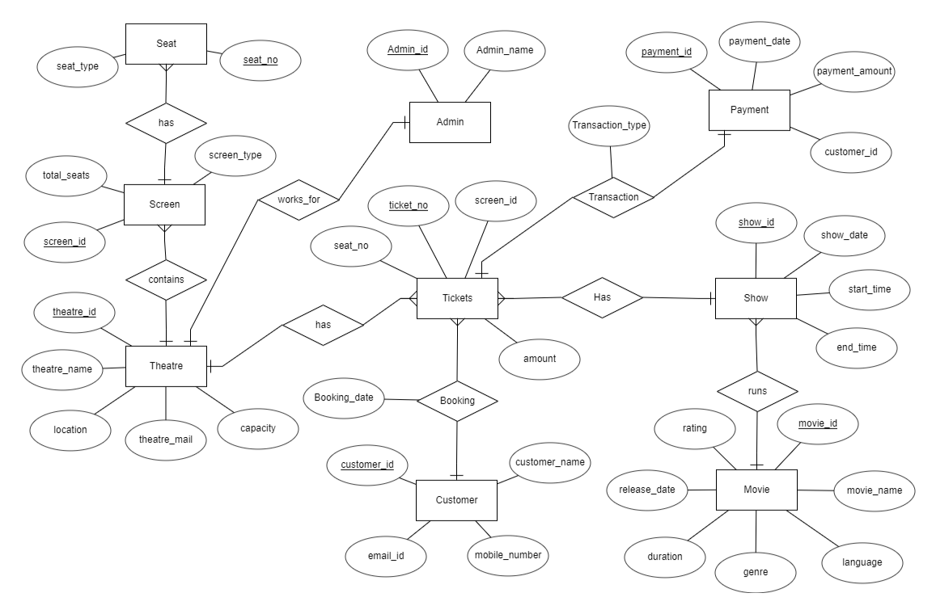
ER Diagram:

Slide 5
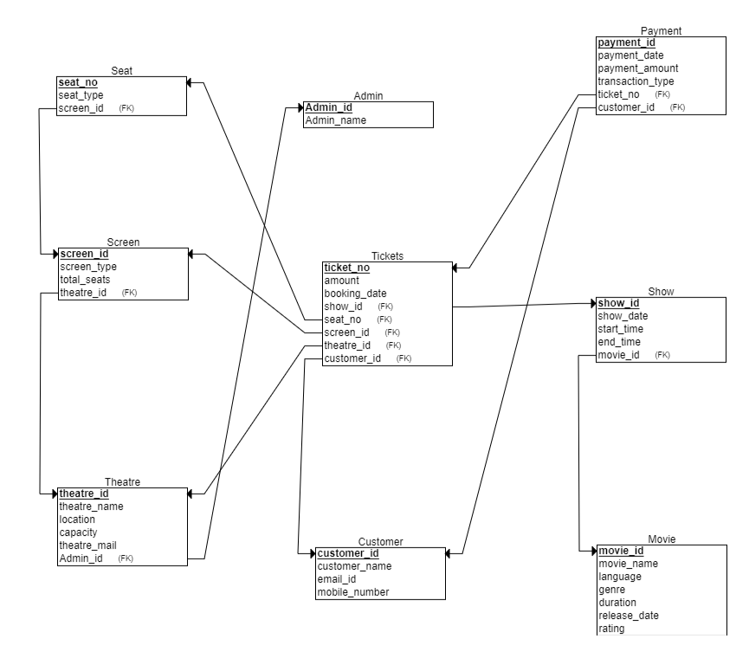
RELATIONAL SCHEMA:

Slide 6
ASSUMPTIONS:
1.We have assumed that one theatre has one admin itself and one admin belongs to one theatre itself.
2.We have assumed that one theatre sells many tickets but each ticket belongs to one theatre itself.
3.We have assumed that one customer can buy many tickets and each ticket is belongs to one customer itself.
4.We have assumed that one ticket has one payment itself and one payment belongs to one ticket.
5.We have assumed that one theatre has many screens but each screen belongs to one theatre itself.
6.We have assumed that one screen has many seats and each seat is belongs to only one screen itself.
7.We have assumed that one movie can be played in many shows but one show should plays only one movie.
8.We have assumed that one show has many tickets and one ticket belongs to one show itself.

Slide 7
Table Ticket:
Ticket entity holds Complete information about tickets such as ticket_no,amount,booking_date,seat_no,customer_id,show_id,screen_id….etc.Its Primary Key is ticket_no and it contains customer_id,show_id,seat_no,screen_id,theatre_id as foreign keys from Customer,Show,Seat,Screen,Theatre.
Table Customer:
Customer entity holds the information of the customer who bought the ticket.It contains the attributes such as customer_id,customer_name,mobile_number,email_id.Here Customer_id is the unique identifier for each customer in the system.
Show:
Show entity holds the information about the Show of the movie whose ticket has been purchased by the customer. It has attributes such as show_id,show_date,start_time,end_time of the movie,movie_id which is foreign key taking reference from Movie entity. Here Show_id is primary key.

Slide 8
Movie:
This entity holds the information about the movie which will be watched by the customer. It contains the attributes such as movie_id,movie_name,language,genre,duration,release_date,rating.Its Primary Key is movie_id.
Payment:
This entity holds the information about the Payment done by the Customer to buy the Movie ticket .Its Stores payment_id,payment_amount,transaction_type(Card, Cash, UPI),ticket_no which is foreign key references from Ticket entity. Its Primary key is Payment_id.
Admin:
This entity holds the information about Admin of the Theatre who sells the Tickets.Such as Admin_id and Admin_name.
Here the Primary Key is admin_id.
Theatre:
This entity holds the information of the theatre details where the movie is being screened.It contains the attributes such as theatre_id,theatre_name,location,capacity,theatre_mail,Admin_id foreign key referencing the Admin entity. Here Primary Key is Theatre_id.

Slide 9
Screen:
This entity holds the information about each screen in Theatre. It contains the attributes such as Screen_id,Screen_type(IMAX,3D,MAXXSCREEN,DOLBY ATMOS),total_seats available in the screen , theatre_id which is foreign key references the theatre. Here the Primary key is screen_id.
Seat:
This entity holds information about the seat of the theatre which has been allocated to the customer to watch the movie. It stores info such as Seat_no , Seat_type( recliner, deluxe, etc.) and screen_id which is foreign key referencing the Screen. Primary key of this entity is Seat_no.

Slide 10
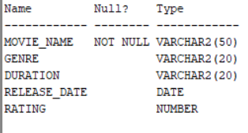
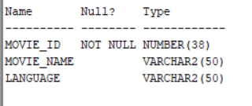
NORMALISATION:
In our relations, MOVIE relation is not in 3NF because it has transitive dependency where the non prime attribute ‘movie_name is determining the attributes language, genre, rating, release date. So we have decomposed the relation into two relations, movie info and movie to make it into 3NF.

Slide 11
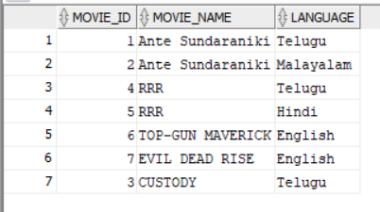
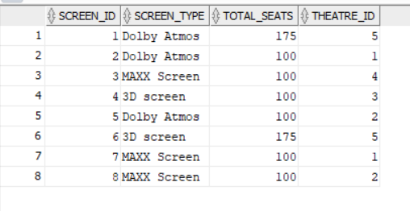
TABLES:
MOVIE: SCREEN:

Slide 12
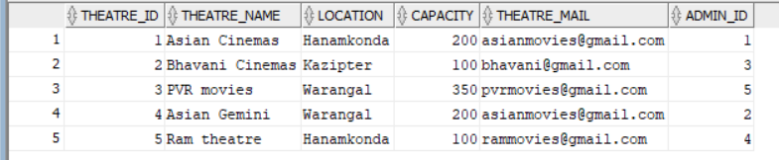
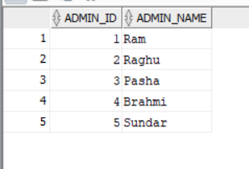
THEATRE:
ADMIN:

Slide 13
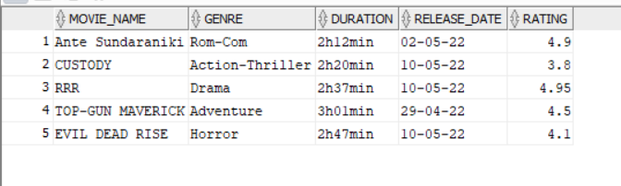
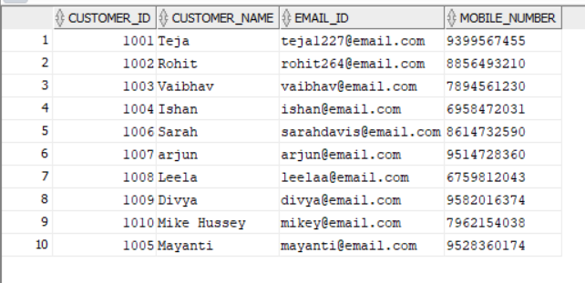
MOVIE_INFO:
CUSTOMER:

Slide 14
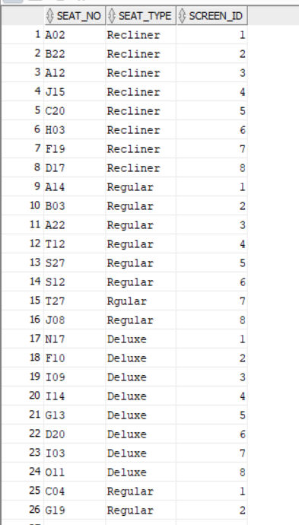
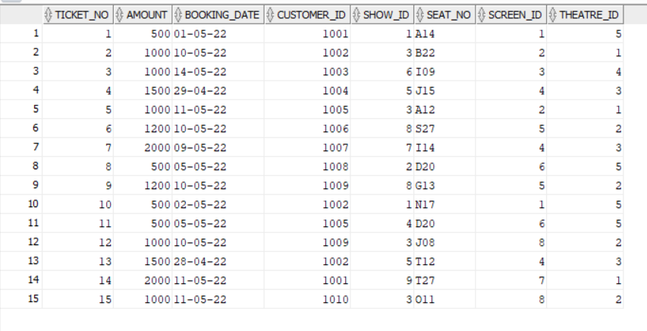
SEAT:
TICKETS:

Slide 15
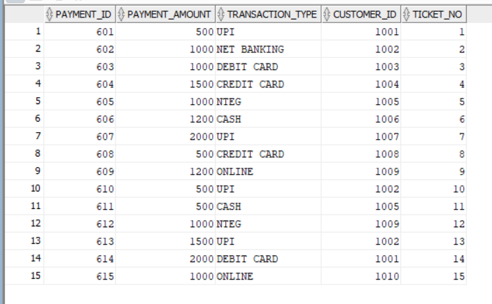
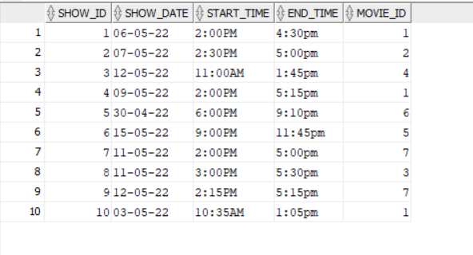
PAYMENT:
SHOW:

Slide 16
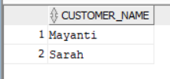
QUERIES:
Write a SQL query to find out customers who paid in cash for tickets.
select distinct c.customer_name from customer c inner join payment p on c.customer_id=p.customer_id and p.transaction_type='CASH';

Slide 17
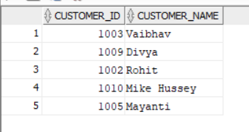
2)Write a SQL query to find out which customer went to the movie RRR.
SELECT DISTINCT c.customer_id,c.customer_name
FROM customer c
inner join tickets t ON c.customer_id = t.customer_id
inner join show s ON t.show_id = s.show_id
inner join movie m ON s.movie_id = m.movie_id
WHERE m.movie_name = 'RRR';

Slide 18
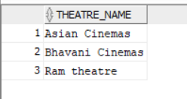
3)Write a SQL query to find out the theatres with more than one screen.
select theatre_name from theatre where theatre_id in( select distinct theatre_id from screen group by theatre_id having count(screen_id)>1);

Slide 19
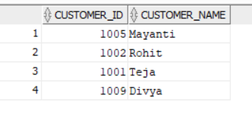
4) Write a SQL query to find out which customer who bought more than 1 ticket.
select customer_id, customer_name from customer where customer_id in( select distinct customer_id from tickets group by customer_id having count(ticket_no)>1);

Slide 20

5) Write a SQL query to find the total tickets revenue for the movie Ante Sundariniki.
SELECT SUM(t.amount) AS total_revenue FROM tickets t INNER JOIN show s ON t.show_id = s.show_id INNER JOIN movie m ON s.movie_id = m.movie_id and m.movie_name = 'Ante Sundaraniki';

Slide 21
THANKYOU

